Slide 1
Processes
Course Code: CSC 2209
Course Title: Operating Systems
Dept. of Computer Science
Faculty of Science and Technology
Lecturer No: | 04 | Week No: |  | Semester: | Summer2022-23
Lecturer: | Taslimur.Rahman@aiub.edu, Taslimur Rahman

Slide 2
Lecture Outline
Process Concept
Process Scheduling
Operations on Processes
Inter-process Communication (IPC)
Examples of IPC Systems
Communication in Client-Server Systems

Slide 3
Process Concept
Process – a program in execution; process execution must progress in sequential fashion
Program is passive entity stored on disk (executable file), process is active
  Program becomes process when executable file loaded into memory
Execution of program started via:
  GUI mouse clicks,
  command line entry of its name,
  etc.
One program can be several processes
  Consider multiple users executing the same program

Slide 4
Process Structure
A process is more than the program code, which is sometimes known as the text section.
It also includes the current activity:
  The value of the program counter
  The contents of the processor's registers.
It also includes the process stack, which contains temporary data (such as function parameters, return addresses, and local variables)
It also includes the data section, which contains global variables, static variable (once created stay forever).
It may also include a heap, which is memory that is dynamically allocated during process run time.

Slide 5
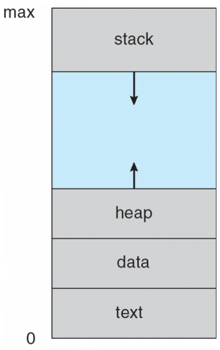
Process in Memory

Slide 6
Process State
As a process executes, it changes state
  new: The process is being created
  running: Instructions are being executed
  waiting: The process is waiting for some event to occur
  ready: The process is waiting to be assigned to a processor
  terminated: The process has finished execution

Slide 7
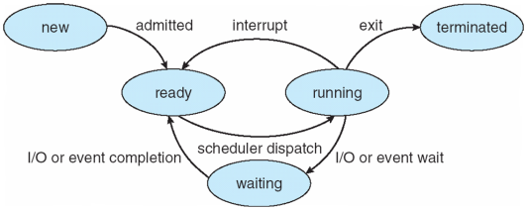
Process State
Diagram of Process State

Slide 8
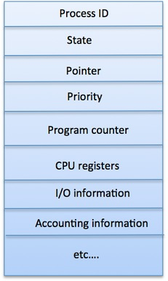
Process Control Block (PCB)
Information associated with each process (use to present a process in OS)
(also called task control block)
Process ID / Number – Unique ID.
Process state – running, waiting, etc.
Program counter – location of instruction to next execute (addr of next inst)
CPU registers – contents of all process-centric registers ()
CPU scheduling information- priorities, scheduling queue pointers
Memory-management information – memory allocated to the process
Accounting information – CPU used, clock time elapsed since start, time limits
I/O status information – I/O devices allocated to process, list of open files

Slide 9
Threads
So far, process has a single thread of execution
Consider having multiple program counters per process
  Multiple locations can execute at once
    Multiple threads of control -> threads
Need storage for thread details, multiple program counters in PCB
Covered in the next chapter

Slide 10
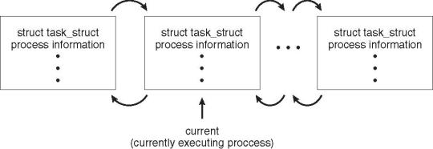
Process Representation in Linux
Represented by the C structure task_struct
pid t_pid; /* process identifier */
long state; /* state of the process */
unsigned int time_slice /* scheduling information */
struct task_struct *parent; /* this process’s parent */
struct list_head children; /* this process’s children */
struct files_struct *files; /* list of open files */
struct mm_struct *mm; /* address space of this process */

Slide 11
Process Scheduling
Maximize CPU use
  Quickly switch processes onto CPU for time sharing
Process “gives” up then CPU under two conditions:
  I/O request
  After N units of time have elapsed (need a timer)
Once a process gives up the CPU it is added to the “ready queue”
Process scheduler selects among available processes in the ready queue for next execution on CPU

Slide 12
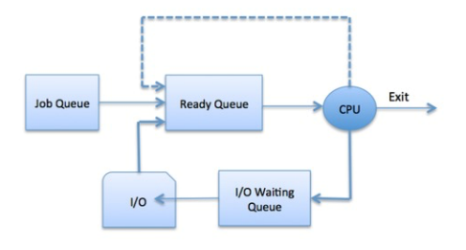
Scheduling Queues
OS Maintains scheduling queues of processes
  Job queue – set of all processes in the system
  Ready queue – set of all processes residing in main memory, ready and waiting to execute
  Device queues – set of processes waiting for an I/O device
  Processes migrate among the various queues

Slide 13
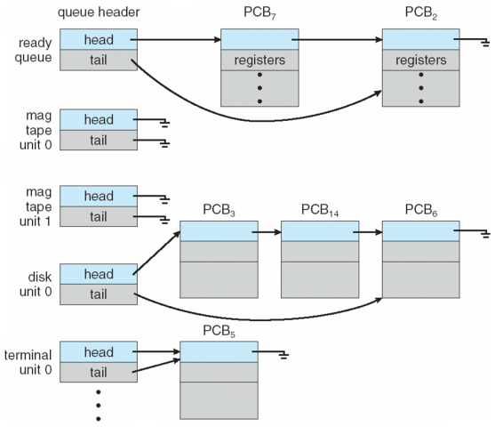
Ready Queue And Various I/O Device Queues

Slide 14
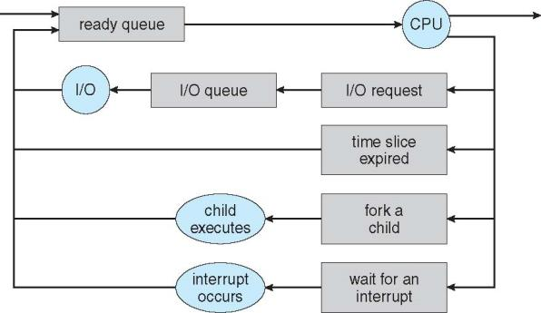
Representation of Process Scheduling
Queuing diagram represents queues, resources, flows

Slide 15
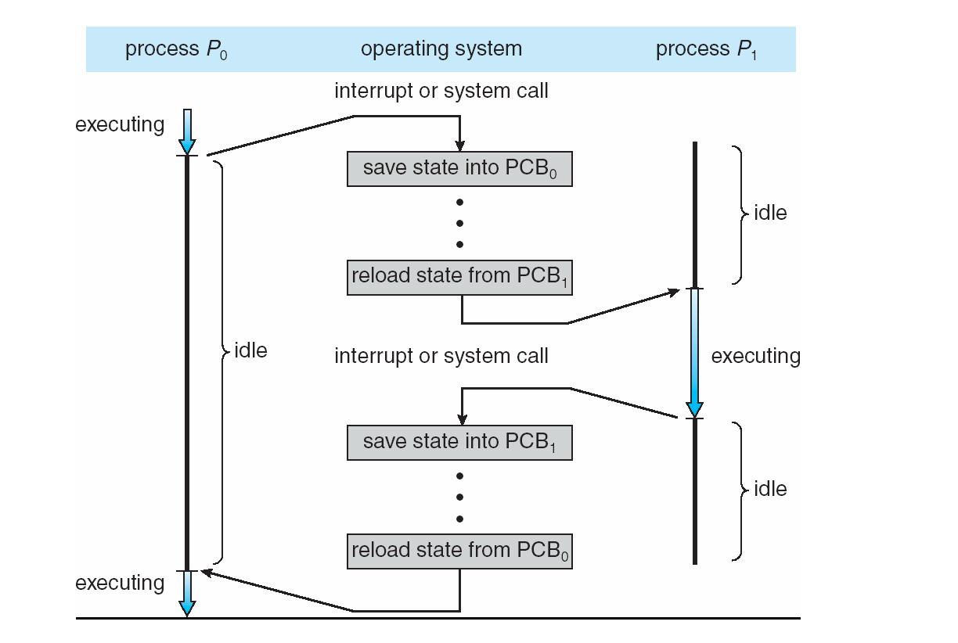
CPU Switch From Process to Process

Slide 16
Schedulers
Short-term scheduler (or CPU scheduler) – selects which process should be executed next and allocates a CPU
  Sometimes the only scheduler in a system
  Short-term scheduler is invoked frequently (milliseconds) ⇒ (must be fast)
Long-term scheduler (or job scheduler) – selects which processes should be brought into the ready queue
  Long-term scheduler is invoked infrequently (seconds, minutes) ⇒ (may be slow)
  The long-term scheduler controls the degree of multiprogramming
Processes can be described as either:
  I/O-bound process – spends more time doing I/O than computations, many short CPU bursts
  CPU-bound process – spends more time doing computations; few very long CPU bursts
Long-term scheduler strives for good process mix

Slide 17
Multitasking in Mobile Systems
Some mobile systems (e.g., early version of iOS) allow only one process to run, others suspended
Starting with iOS 4, it provides for a
  Single foreground process – controlled via user interface
  Multiple background processes – in memory, running, but not on the display, and with limits
  Limits include single, short task, receiving notification of events, specific long-running tasks like audio playback
Android runs foreground and background, with fewer limits
  Background process uses a service to perform tasks
  Service can keep running even if background process is suspended
  Service has no user interface, small memory use

Slide 18
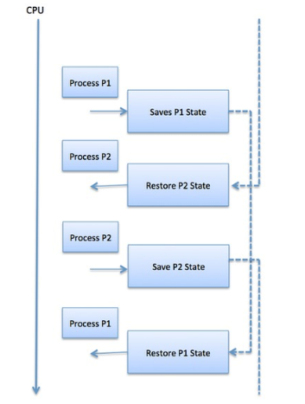
Context Switch
When CPU switches to another process, the system must save the state of the old process and load the saved state for the new process via a context switch
Context of a process represented in the PCB
Context-switch time is pure overhead; the system does no useful work while switching
  The more complex the OS and the PCB ➔ the longer the context switch
Time dependent on hardware support
  Some hardware provides multiple sets of registers per CPU ➔ multiple contexts loaded at once

Slide 19
Operations on Processes
System must provide mechanisms for:
  process creation,
  process termination,
  and so on as detailed next

Slide 20
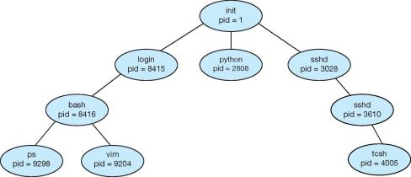
Process Creation
A process may create other processes.
Parent process create children processes, which, in turn create other processes, forming a tree of processes
Generally, a process is identified and managed via a process identifier (pid)
A Tree of Processes in UNIX

Slide 21
Process Creation (cont’d)
Resource sharing among parents and children options
  Parent and children share all resources
  Children share subset of parent’s resources
  Parent and child share no resources
Execution options
  Parent and children execute concurrently
  Parent waits until children terminate

Slide 22
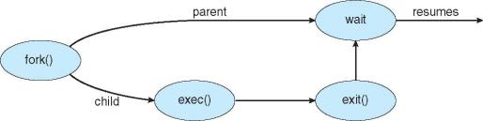
Process Creation (cont’d)
Address space
  A child is a duplicate of the parent address space.
  A child loads a program into the address space.
UNIX examples
  fork() system call creates new process
  exec() system call used after a fork()replaces the process’ memory space with a new program

Slide 23
C program to create a separate process in UNIX
int main()
{
pit.t pid;
/*fork a child process */
pid = fork();
if (pid < 0) { /* error occurred */
fprintf(stderr, “Fork Failed”);
return 1;
}
else if (pid == 0) { /*child process */
execlp(“/bin/ls”,”ls”,NULL);
}
else { /* parent process */
/* parent will wait for the child to complete */
wait(NULL);
printf(“Child Complete”);
}
return 0;
}

Slide 24
C Program Forking Separate Process
The C program illustrates how to create a new process UNIX.
After fork() there are two different processes running copies of the same program. The only difference is that the value of pid for the child process is zero, while that for the parent is an integer value greater than zero
The child process inherits privileges and scheduling attributes from the parent, as well certain resources, such as open files.
The child process then overlays its address space with the UNIX command “ls” (used to get a directory listing) using the execlp() (a version of the exec() system call).
The parent waits for the child process to complete with the wait() system call.
When the child process completes, the parent process resumes from the call to wait(), where it completes using the exit() system call.

Slide 25
Creating a Separate Process via Windows API
int main(VOID)
{
STARTUPINFO si;
PROCESS_INFORMATION pi;
/* allocate memory */
ZeroMemory(&si, sizeof(si));
si.cb = sizeof(si);
ZeroMemory(&pi, sizeof(pi));
/* create child process */
if (!CreateProcess(NULL, /* use command line */
“C:\\WINDOWS\\system32\\mspaint.exe”,/* command */
NULL, /* don’t inherit process handle */
NULL, /* don’t inherit threat handle */
FALSE, /* disable handle inheritance */
0, /* no creation flags */
NULL, /* use parent’s environment block */
NULL, /* use parent’s existing directory */
&si,
&pi))
{

Slide 26
Creating a Separate Process via Windows API (cont’d)
{
fprintf{stderr, “Create Process Failed”};
return -1;
}
/* parent will wait for the child to complete */
WaitForSingleObject(pi.hProcess, INFINITE);
printf(“Child Complete”);
/* close handles */
CloseHandle(pi.hProcess);
CloseHandle(pi.hThread);
}

Slide 27
Process Termination
A process terminates when it finishes executing its final statement and it asks the operating system to delete it by using the exit() system call.
  At that point, the process may return a status value (typically an integer) to its parent process (via the wait() system call. )
  All the resources of the process are deallocated by the operating system.
A parent may terminate the execution of children processes using the abort() system call. Some reasons for doing so:
  Child has exceeded allocated resources
  Task assigned to child is no longer required
  The parent is exiting and the operating systems does not allow a child to continue if its parent terminates

Slide 28
Process Termination (cont’d)
Some operating systems do not allow a child process to exists if its parent has terminated. If a process terminates, then all its children must also be terminated.
  cascading termination. All children, grandchildren, etc. are terminated.
  The termination is initiated by the operating system.
The parent process may wait for termination of a child process by using the wait()system call. The call returns status information and the pid of the terminated process
pid = wait(&status);
If no parent waiting (did not invoke wait()) process is zombie
  Status table yes but running no but parent process need to call exit() system
If parent terminated without invoking wait (), process is orphan
  Running yes but parent running no
Notes:
An orphan process is a computer process whose parent process has finished or terminated, though it (child process) remains running itself.
A zombie process or defunct process is a process that has completed execution but still has an entry in the process table as its parent process didn't invoke an wait() system call.

Slide 29
Inter process Communication (IPC)
Processes within a system may be independent or cooperating
  Cooperating processes can affect or be affected by other processes, including sharing data
  Independent processes cannot affect other processes
Reasons for having cooperating processes:
  Information sharing
  Computation speedup (multiple processes running in parallel- subtasks divided into processes)
  Modularity (system design- several modules/process need comm.)
  Convenience (multitasking-multiprogramming make user life easy)
Cooperating processes need inter process communication (IPC)

Slide 30
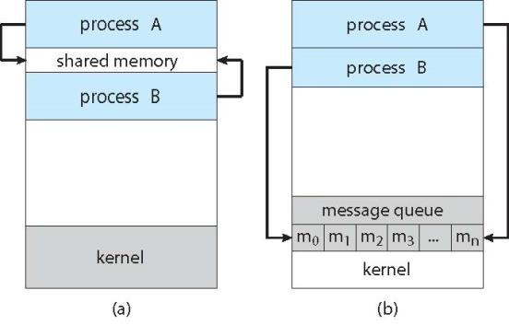
Communications Models
Two models of IPC (Inter process communication)
  Shared memory
  Message passing

Slide 31
Shared Memory Systems
A region of memory that is shared by cooperating processes.
An area of memory shared among the processes that wish to communicate
The communication is under the control of the users processes not the operating system.
Major issues is to provide mechanism that will allow the user processes to synchronize their actions when they access shared memory.

Slide 32
Synchronization
Cooperating processes that access shared data need to synchronize their actions to ensure data consistency
Maintaining data consistency requires mechanisms to ensure the orderly execution of cooperating processes
Illustration of the problem – The producer-Consumer problem
  Producer process produces information that is consumed by a Consumer process.
  The information is passed from the Producer to the Consumer via a buffer.
  Two types of buffers can be used:
    unbounded-buffer places no practical limit on the size of the buffer
    bounded-buffer assumes that a fixed buffer size

Slide 33
Bounded-Buffer Solution
Shared data
      #define BUFFER_SIZE 10
      typedef struct {
      . . .
      } item;
      item buffer[BUFFER_SIZE];
      int in = 0;
      int out = 0;
Solution presented in the next two slides is correct, but only 9 out of 10 buffer elements can be used

Slide 34
Bounded-Buffer – Producer
      item next_produced;
      while (true) {
      /* produce an item in next produced */
      while (((in + 1) % BUFFER_SIZE) == out)
      ; /* do nothing */
      buffer[in] = next_produced;
      in = (in + 1) % BUFFER_SIZE;
      }

Slide 35
Bounded Buffer – Consumer
item next_consumed;
while (true) {
while (in == out)
; /* do nothing */
next_consumed = buffer[out];
out = (out + 1) % BUFFER_SIZE;
/* consume the item in next consumed */
}

Slide 36
Message Passing Systems
Mechanism for processes to communicate and to synchronize their actions (messages are exchanged between processes)
  Without resorting to shared variables
IPC facility provides two operations:
  send(message)
  receive(message)
The message size is either fixed or variable

Slide 37
Message Passing (cont’d)
If processes P and Q wish to communicate, they need to:
  Establish a communication link between them
  Exchange messages via send/receive
Implementation issues:
  How are links established?
  Can a link be associated with more than two processes?
  How many links can there be between every pair of communicating processes?
  What is the capacity of a link?
  Is the size of a message that the link can accommodate fixed or variable?
  Is a link unidirectional or bi-directional?

Slide 38
Implementation of Communication Link
Physical:
  Shared memory
  Hardware bus
  Network
Logical:
  Direct or indirect
  Synchronous or asynchronous
  Automatic or explicit buffering

Slide 39
Direct Communication
Processes must name each other explicitly:
  send (P, message) – send a message to process P
  receive(Q, message) – receive a message from process Q
Properties of communication link
  Links are established automatically
  A link is associated with exactly one pair of communicating processes
  Between each pair there exists exactly one link
  The link may be unidirectional, but is usually bi-directional

Slide 40
Indirect Communication
Messages are directed and received from mailboxes (also referred to as ports)
  Each mailbox has a unique id
  Processes can communicate only if they share a mailbox
Operations
  create a new mailbox (port)
  send and receive messages through mailbox
  delete a mailbox
Primitives are defined as:
  send(A, message) – send a message to mailbox A
  receive(A, message) – receive a message from mailbox A

Slide 41
Indirect Communication (cont’d)
Properties of communication link
  Link established only if processes share a common mailbox
  A link may be associated with many processes
  Each pair of processes may share several communication links
  Link may be unidirectional or bi-directional

Slide 42
Indirect Communication Issues
Mailbox sharing
  P₁, P₂, and P₃ share mailbox A
  P₁, sends; P₂ and P₃ receive
  Who gets the message?
Solutions
  Allow a link to be associated with at most two processes
  Allow only one process at a time to execute a receive operation
  Allow the system to select arbitrarily the receiver. Sender is notified who the receiver was. (Algorithm like RR)

Slide 43
Blocking and Non-blocking schemes
Message passing may be either blocking or non-blocking
Blocking is considered synchronous
  Blocking send -- the sender is blocked until the message is received
  Blocking receive -- the receiver is blocked until a message is available
Non-blocking is considered asynchronous
  Non-blocking send -- the sender sends the message and continue
  Non-blocking receive -- the receiver receives:
    A valid message, or
    Null message
Different combinations possible
  If both send and receive are blocking, we have a rendezvous

Slide 44
Buffering
Whether communication is direct or indirect, messages exchanged by communicating processes reside in a temporary queue.
Such queues can be implemented in three ways:
  1. Zero capacity – no messages are queued on a link. Sender must wait for receiver (rendezvous)
  2. Bounded capacity – finite length of n messages Sender must wait if link full
  3. Unbounded capacity – infinite length Sender never waits

Slide 45
Example of IPC Systems
There are four different IPC systems.
  POSIX API for shared memory
  Mach operating system, which uses message passing
  Windows IPC, which uses shared memory as a mechanism for providing certain types of message passing.
  Pipes, one of the earliest IPC mechanisms on UNIX systems.

Slide 46
Mach
Mach communication is message based
  Even system calls are messages
  Each task gets two mailboxes at creation- Kernel and Notify
  Only three system calls needed for message transfer
  msg_send(), msg_receive(), msg_rpc()
  Mailboxes needed for commuication, created via
  port_allocate()
  Send and receive are flexible, for example four options if mailbox full:
    Wait indefinitely
    Wait at most n milliseconds
    Return immediately
    Temporarily cache a message

Slide 47
Windows
Message-passing centric via advanced local procedure call (LPC) facility
  Only works between processes on the same system
  Uses ports (like mailboxes) to establish and maintain communication channels
  Communication works as follows:
    The client opens a handle (an abstract reference to a resource) to the subsystem’s connection port object.
    The client sends a connection request.
    The server creates a private communication port and returns the handle to the client.
    The client and server use the corresponding port handle to send messages or callbacks and to listen for replies.

Slide 48
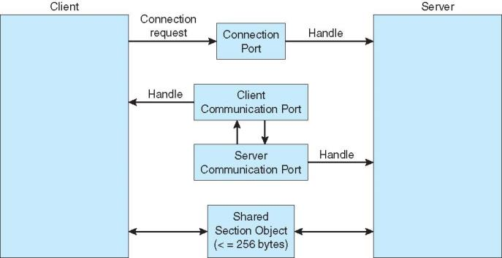
Local Procedure Calls in Windows

Slide 49
Communications in Client-Server Systems
Sockets
Remote Procedure Calls
Remote Method Invocation (Java)

Slide 50
Books
Operating Systems Concept
  Written by Galvin and Silberschatz
  Edition: 9th

Slide 51
References
Operating Systems Concept
  Written by Galvin and Silberschatz
  Edition: 9th

